Slide 1
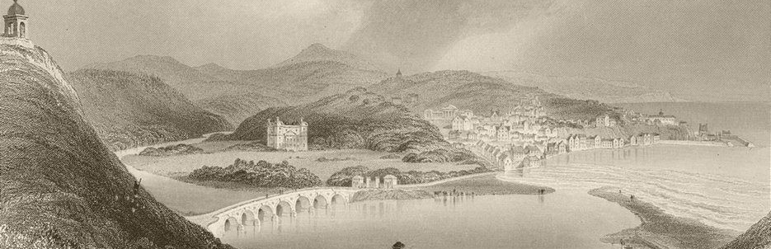
How do we make better graphs? Effective visual communication for the quantitative scientist
Mark Baillie
June 6th, 2019

Slide 2
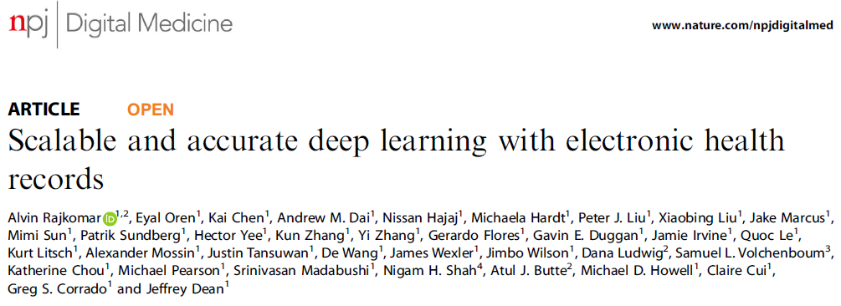

Slide 3
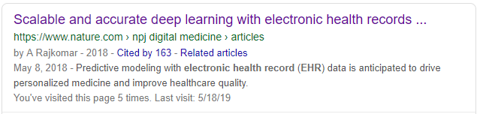

Slide 4
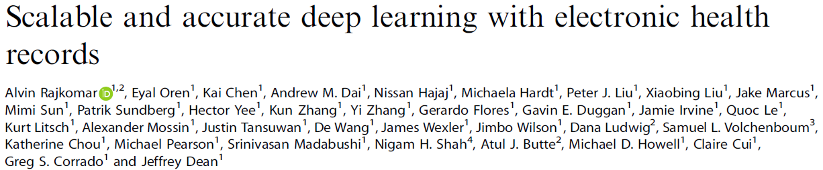
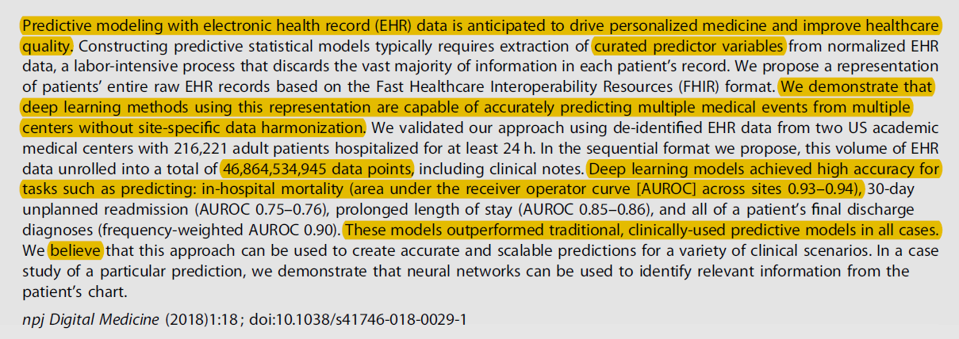

Slide 5
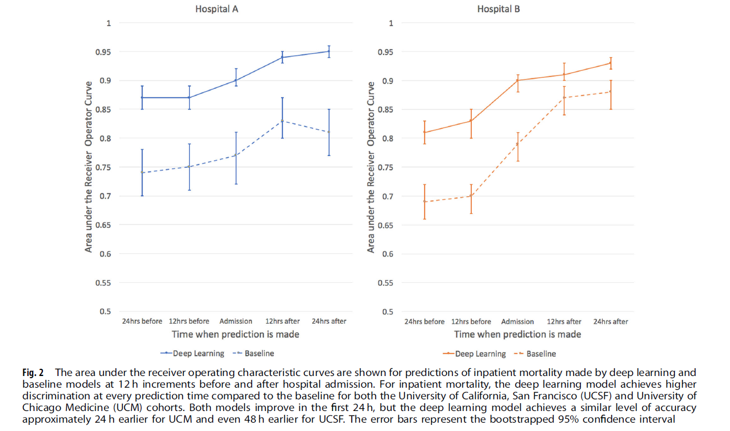

Slide 10
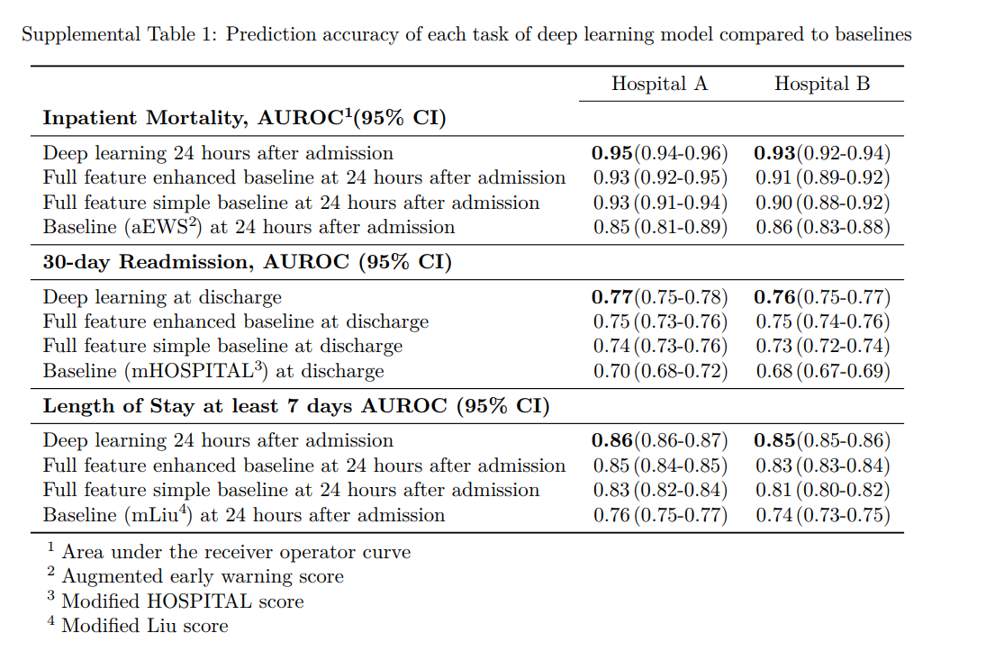

Slide 11
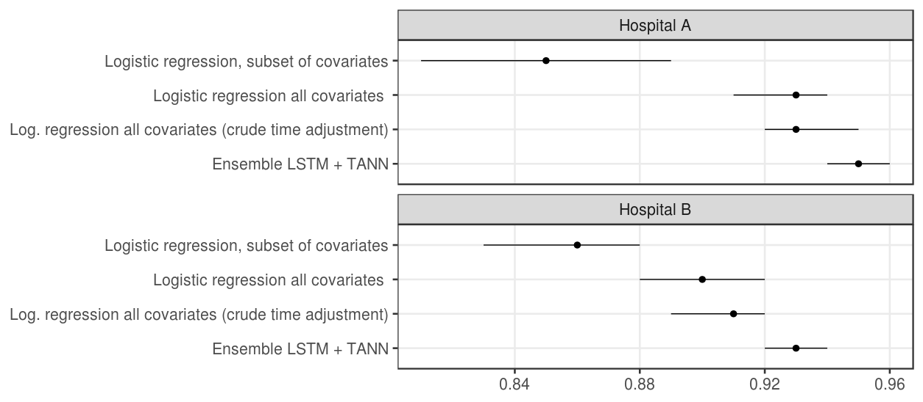
Optimised deep learning ensembles are not the driver of “accuracy”

Slide 12
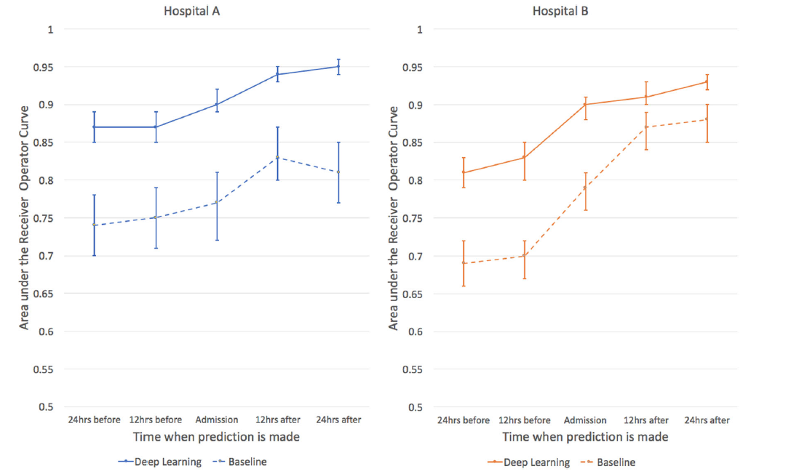
We presented our “best” model and compared it to an inappropriate baseline

Slide 13
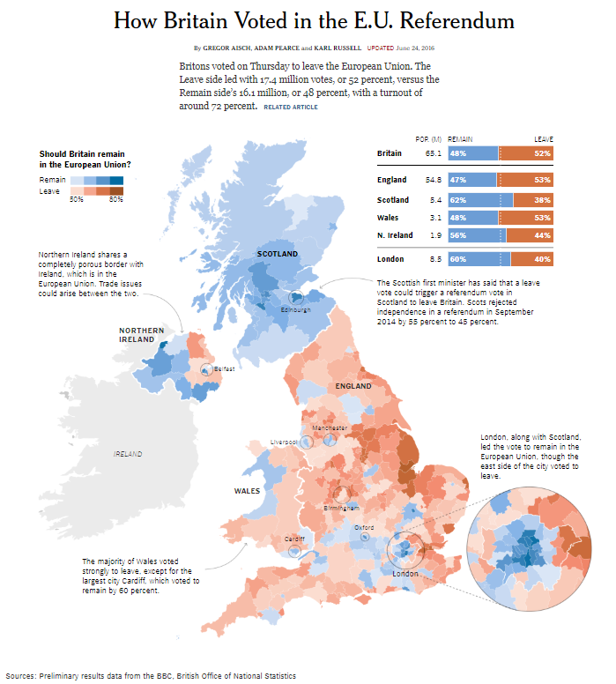
Effective visualisation is important
https://www.nytimes.com/interactive/2016/06/24/world/europe/how-britain-voted-brexit-referendum.html

Slide 14
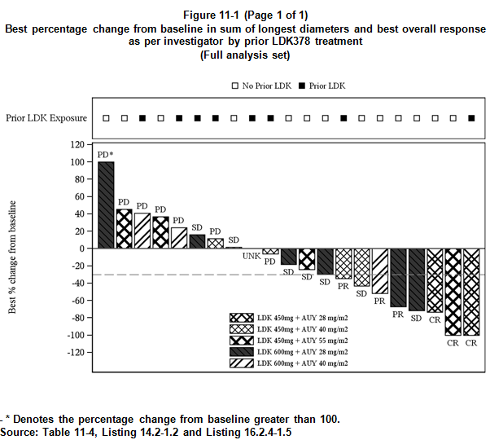
We are not always good at it

Slide 15
Visualisation panel
“Visualization and the use of graphics can help at every stage of an analysis, from the planning and design of an experiment, the very first data explorations, through to the communication of conclusions and recommendations. Visualization is more than "plotting data"; it can lead to a deeper understanding and inform next steps.
The role of the STRATOS visualization panel is to promote the use of good graphical principles for effective visual communication, providing guidance and recommendations covering all aspects from the design, implementation and review of statistical graphics.”

Slide 16
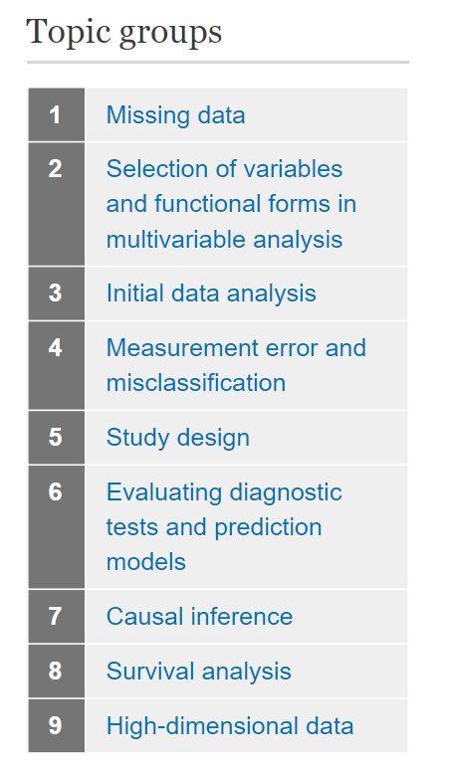
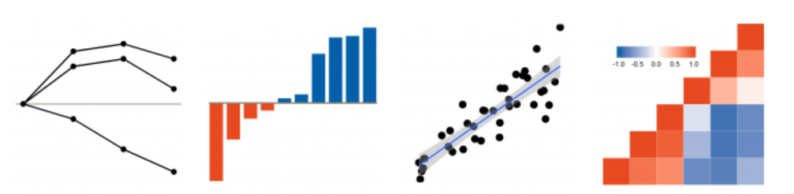
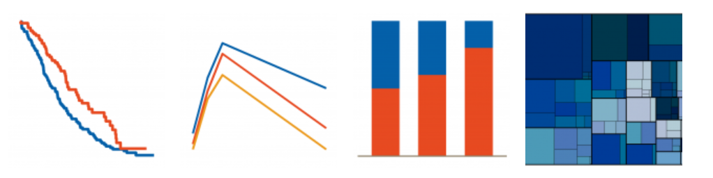
Effective visualisation is important throughout the workflow

Slide 17
Elements of the initiative
Graphical principles and thinking
Graphics Principles Cheat Sheet
Newsletter
Easing the implementation
Graph Gallery
Analysis Results Datasets
Standardization of most common/important graphs
Graphics tomorrow ... or today?
Question‐based visualizations and interactive graphics
...plus overarching stakeholder management and communication

Slide 18
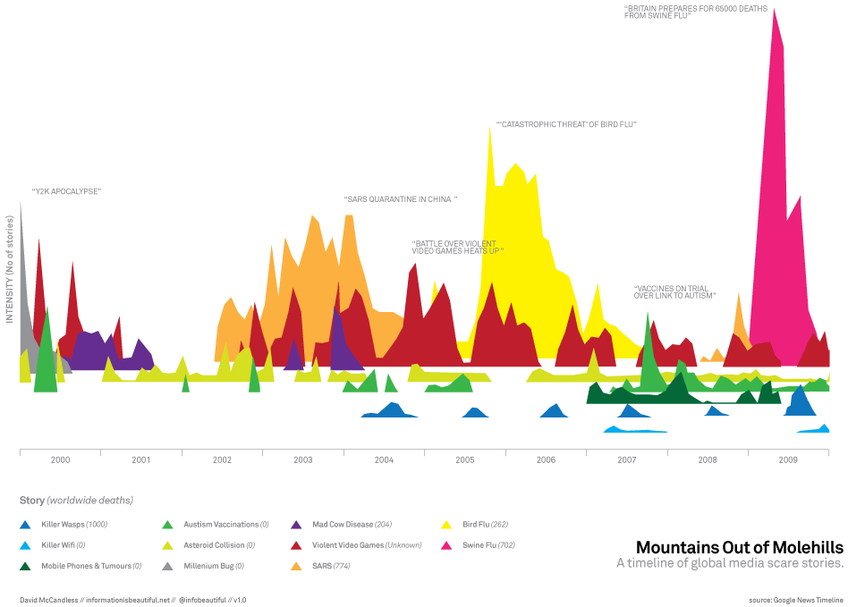
Beautiful but effective?

Slide 19
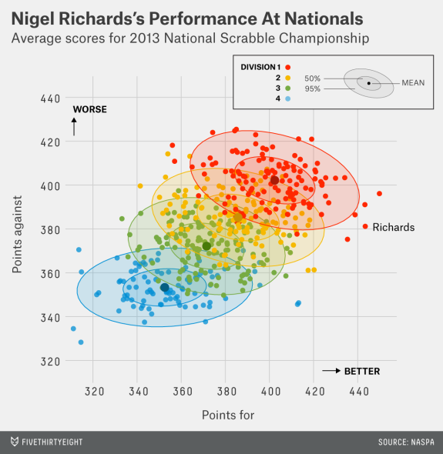
Beautiful and effective?

Slide 20
Effective data visualisation is effective visual communication
Effective graphs...
are visually appealing, intuitive, legible
use the correct graph type and axis scales
use proximity & alignment to facilitate comparison
use labels and annotations to add clarity to the message
Most importantly, effective use of visualisations
Enables clear and impactful communication
Elevates influence with stakeholders
Facilitates informed decision making

Slide 21
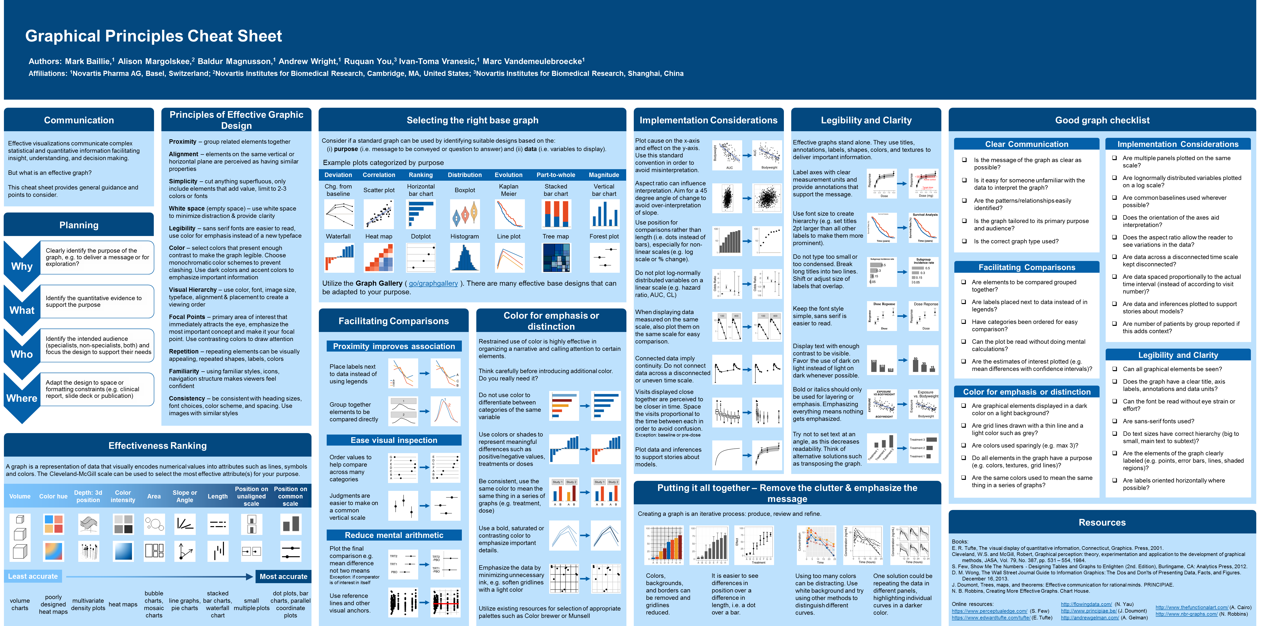
Principles for effective visual communication

Slide 22
Use the cheat sheet for design and planning
Why
Clearly identify the purpose of the graph, e.g. to deliver a message or for exploration?
What
Identify the quantitative evidence to support the purpose
Who
Identify the intended audience (specialists, non-specialists, both) and focus the design to support their needs
Where
Adapt the design to space or formatting constraints (e.g. clinical report, slide deck or publication)
https://graphicsprinciples.github.io/

Slide 23
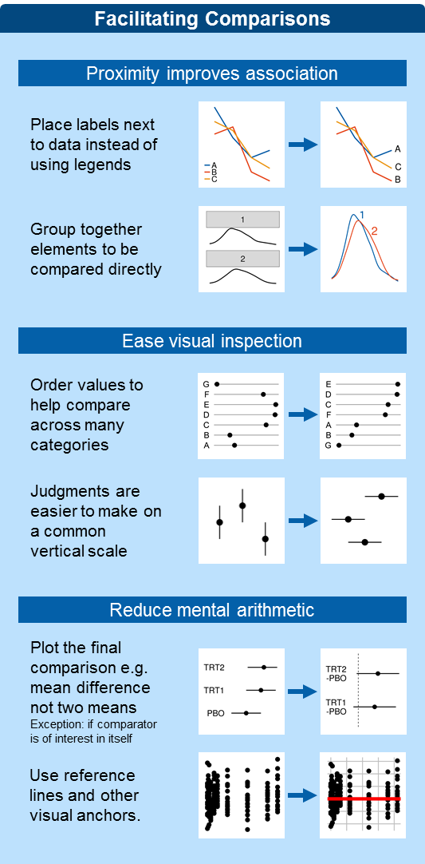
Use the cheat sheet for critical review

Slide 24
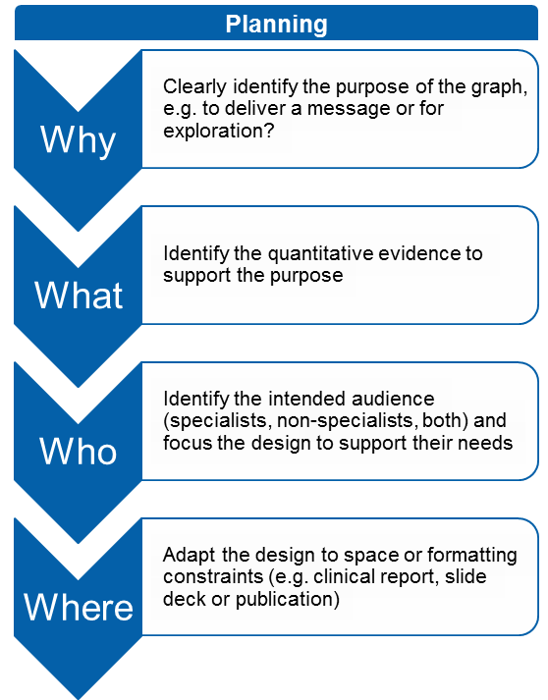
Use the cheat sheet for critical review

Slide 25
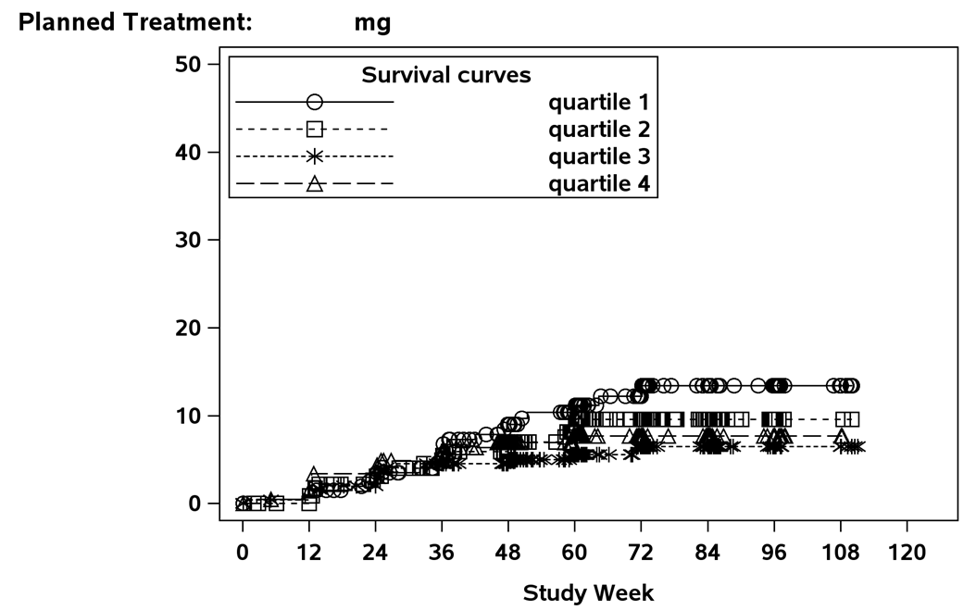
This is a continual process

Slide 26
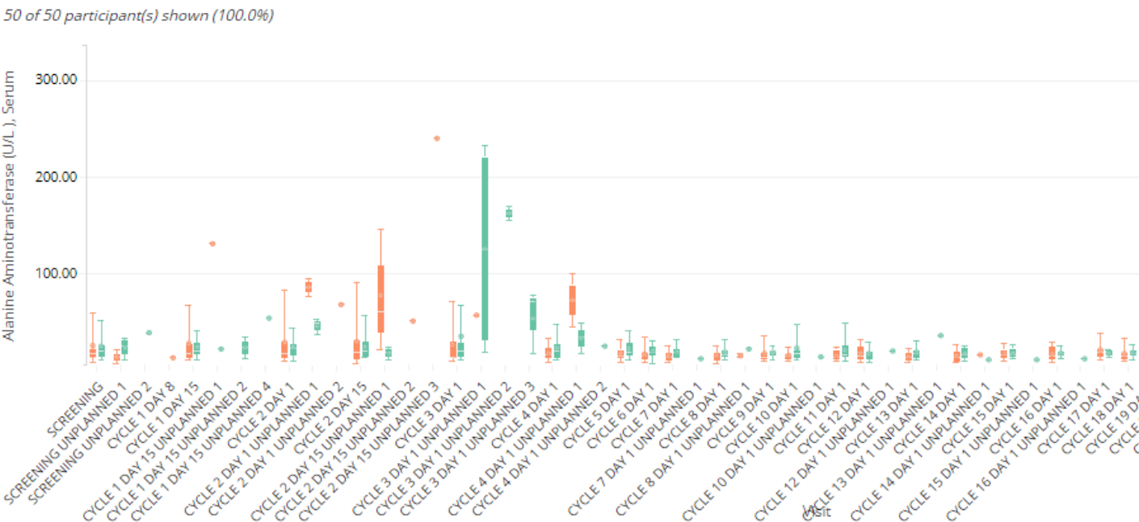
This is a continual process

Slide 27
Three laws for improving visual communication
Have a clear purpose
Know the purpose of creating the graph
Identify the quantitative evidence to support the purpose
Identify the audience and focus the design to support their needs
Show the data clearly
Choose the appropriate graph type to display your data
Avoid misrepresentation (use appropriate scales)
Maximize data to ink ratio (reduce distraction, less is more)
Make the message obvious
Use proximity and alignment to aid in comparisons
Minimize mental arithmetic (e.g. plot the difference)
Use colors and annotations to highlight important details
https://arxiv.org/abs/1903.09512

Slide 28
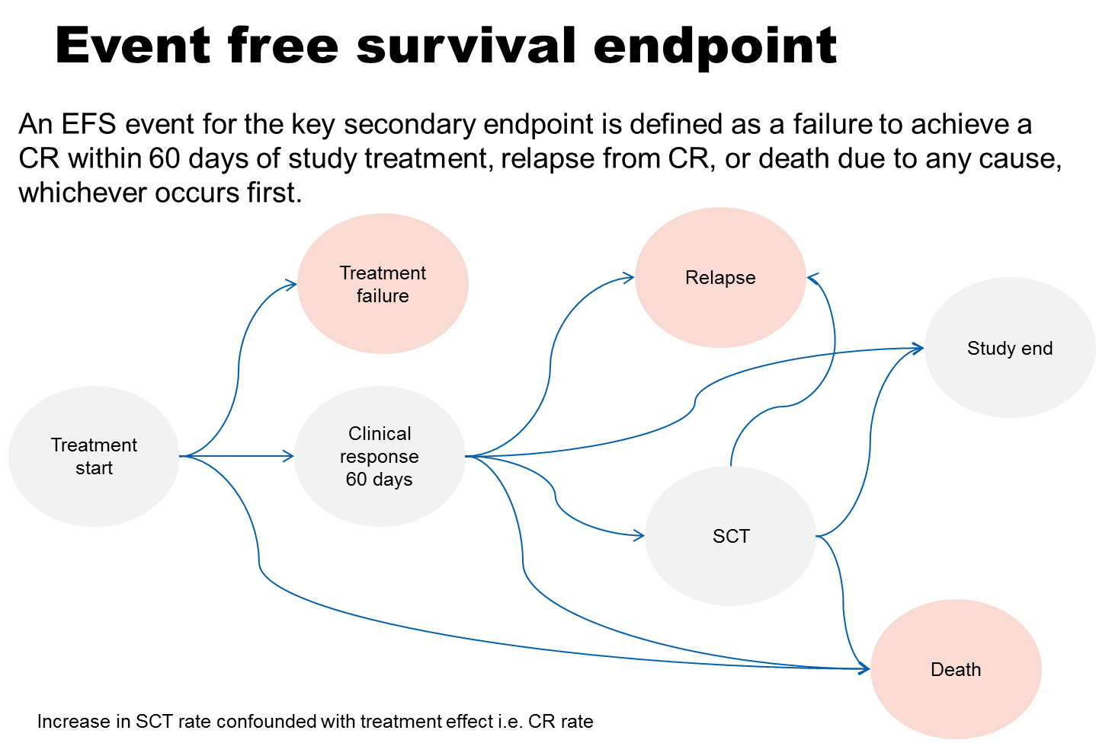
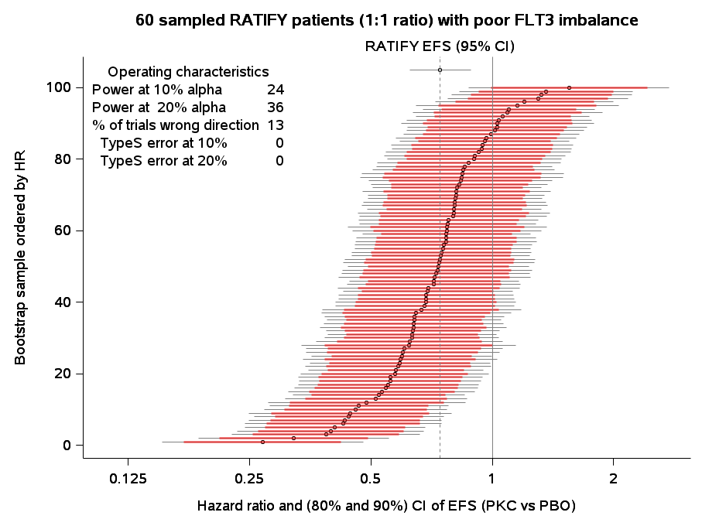
Effective visualization is important for planning

Slide 29

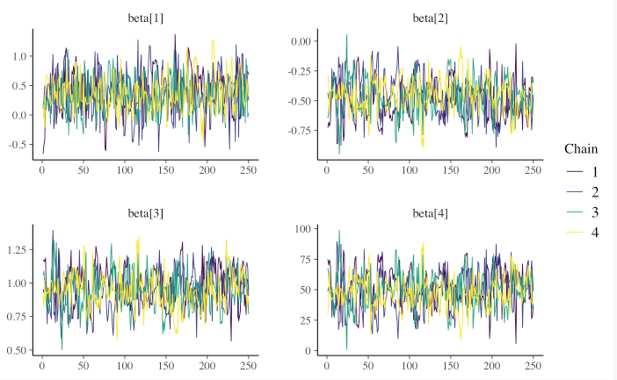
Effective visualization is important during exploratory analysis
https://mc-stan.org/bayesplot/reference/MCMC-traces.html

Slide 30
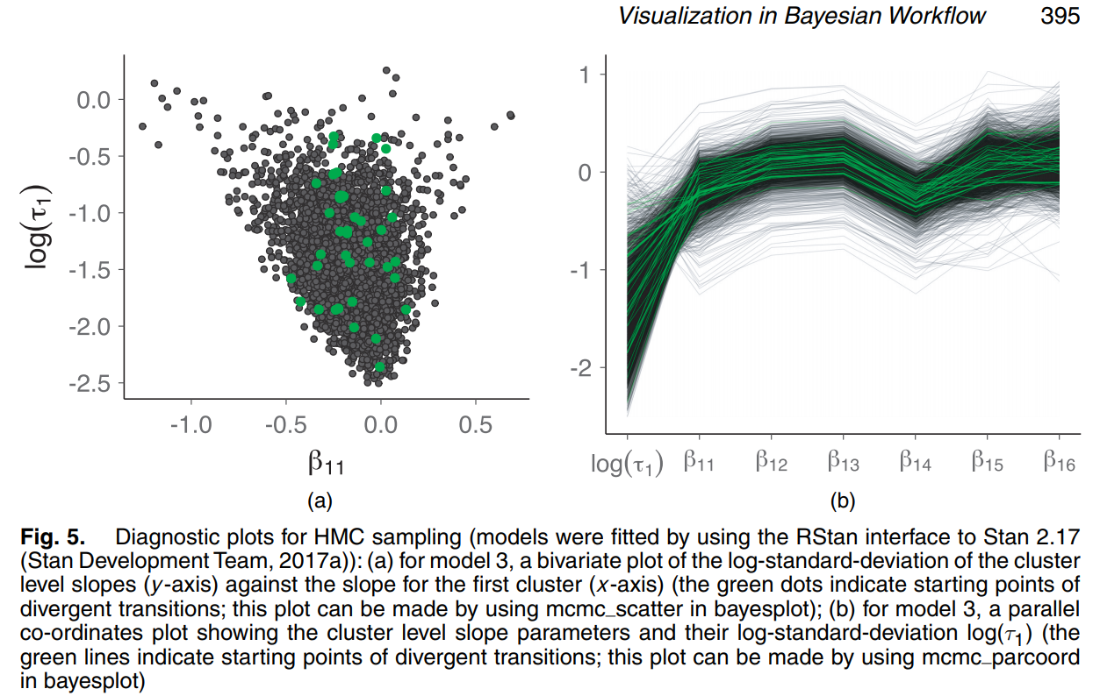
Effective visualization is important during exploratory analysis

Slide 31
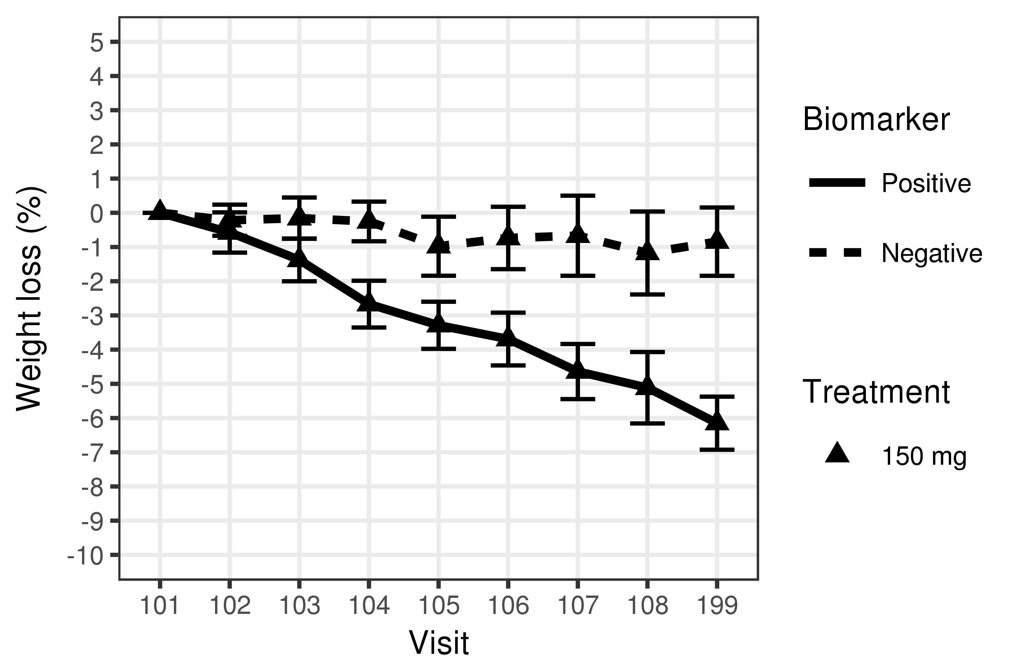
Effective visualization important for reporting
%improvement in baseline weight through week 12 by subgroup

Slide 32
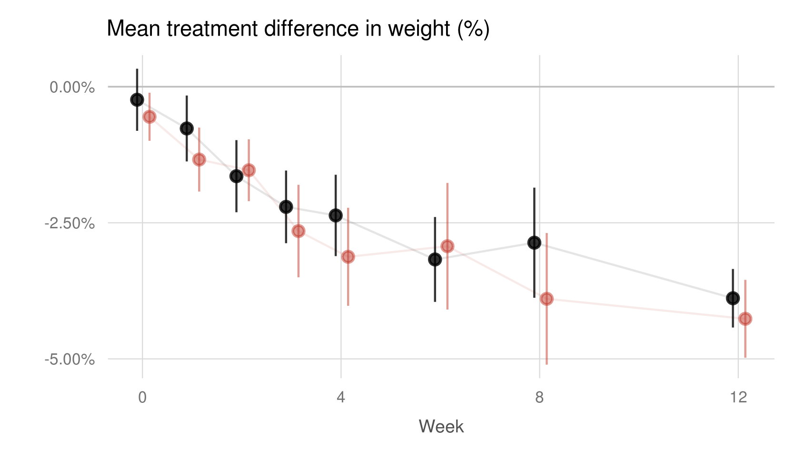
Genetic marker positive is not predictive of treatment response
Genetic marker negative
Treatment
benefit
Genetic marker positive
The average treatment effect is similar in both the genetic marker positive and negative subgroups and does not warrant further investigation

Slide 33
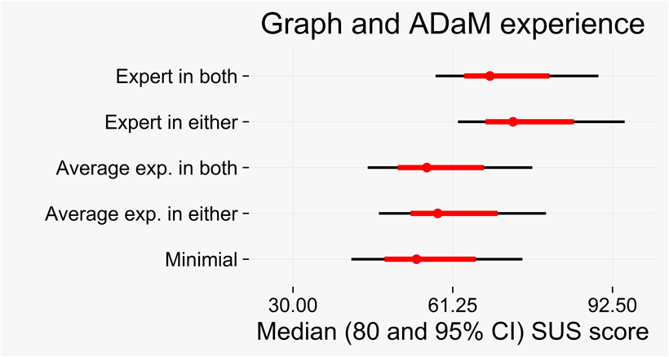
How can the VP help across skill levels?
A survey was sent to associates working with clinical data
The purpose to:
evaluate ADaM as a data standard for graph production
Identify key issues associates currently experience
Explore issues related to role and experience level
85 respondents

Slide 34
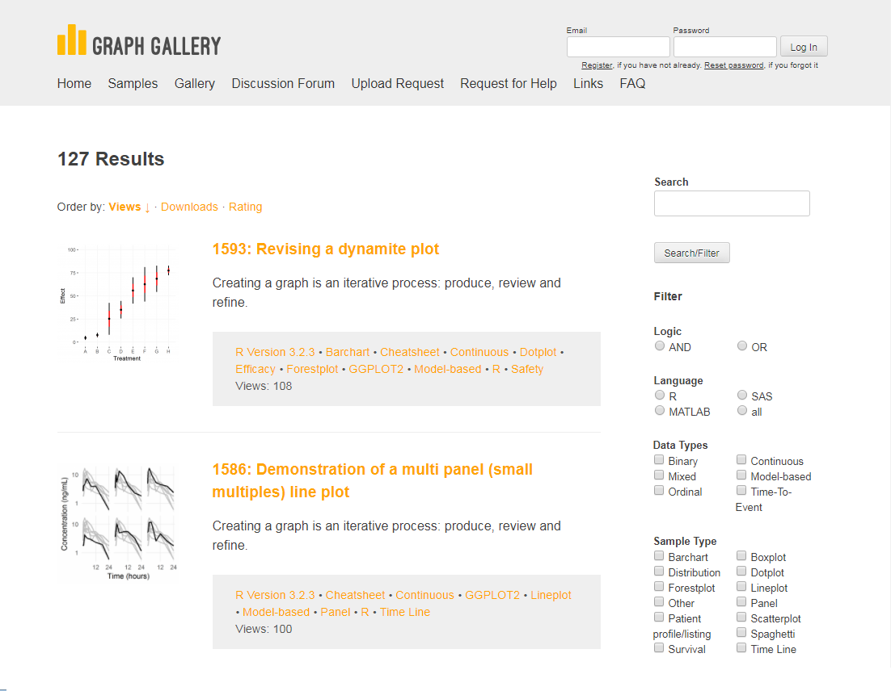
Provide access to examples with code and data

Slide 35
How can the VP help with implementation across skill levels?
(Negative) qualitative comments
Complex graphs such as Forest Plots will need a fair amount of data manipulation to get all needed for input to the graph
some variables needed for graphs are not in ADaM datasets
Trying to figure out what the different parameters mean and extracting the information relevant to my task.

Slide 36
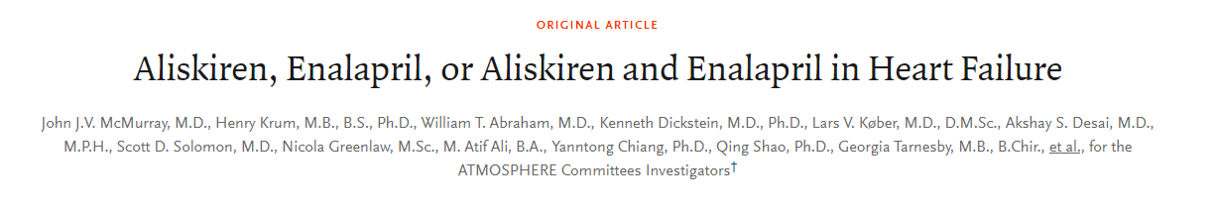
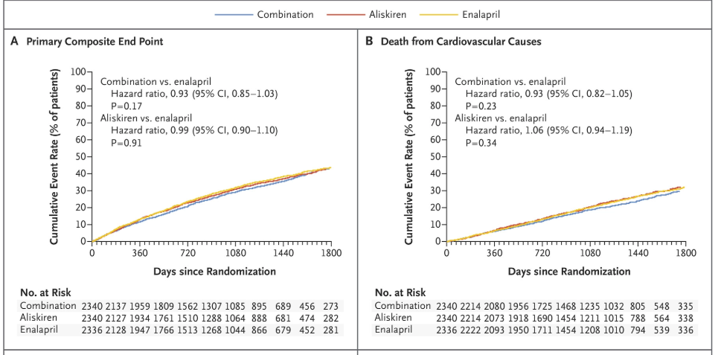

Slide 37
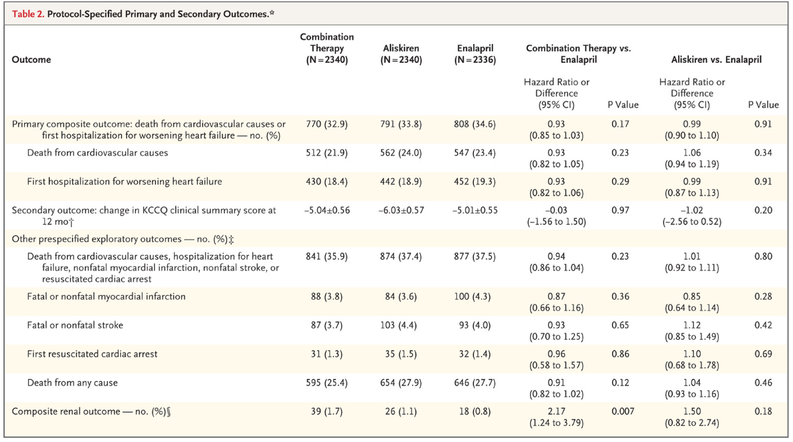

Slide 38
Analysis results data sets

Slide 39
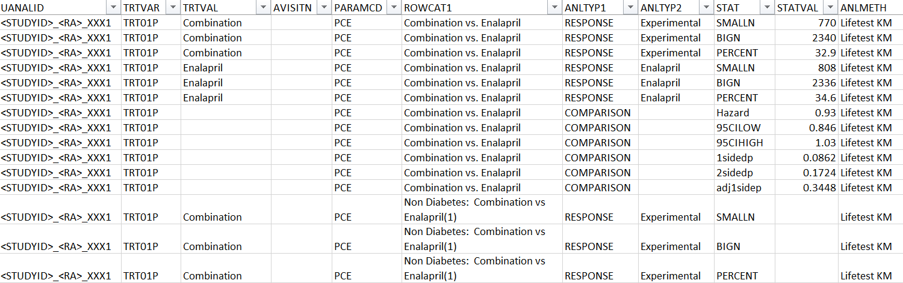

Slide 40
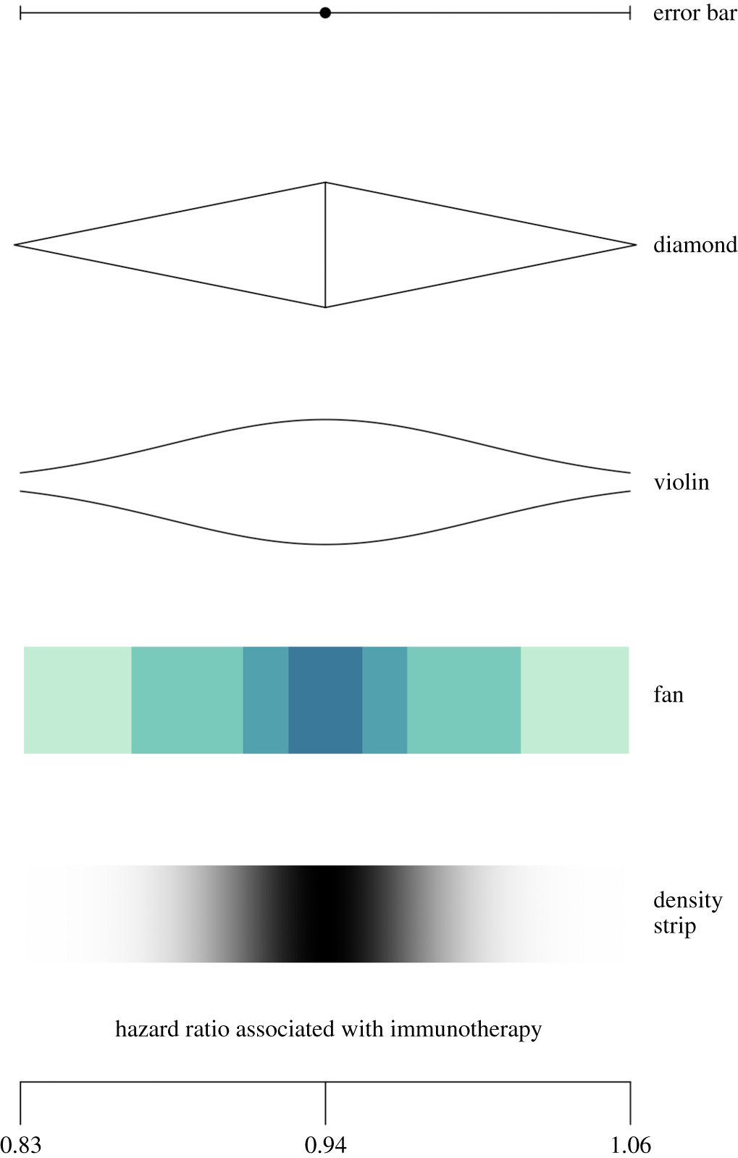
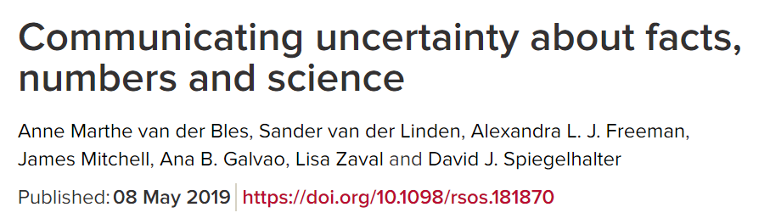
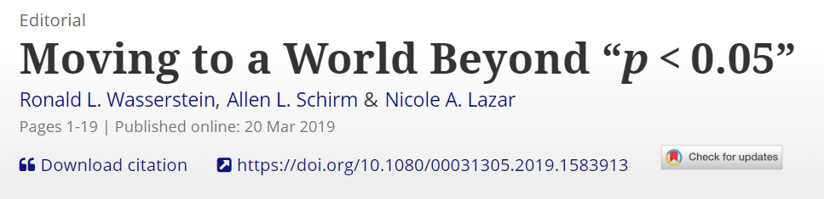
Open challenges: communicating uncertainty
Notes:
Potentially new experiments (long term goals)
What actually works under what situations
Communicating uncertainty is an important topic – Speiglhalter
P-values – how to communicate scientific uncertainty without p-values
Visualization is going to play a key part
Show uncertainty plot to capture the idea [for p-values or to replace p-values]

Slide 41
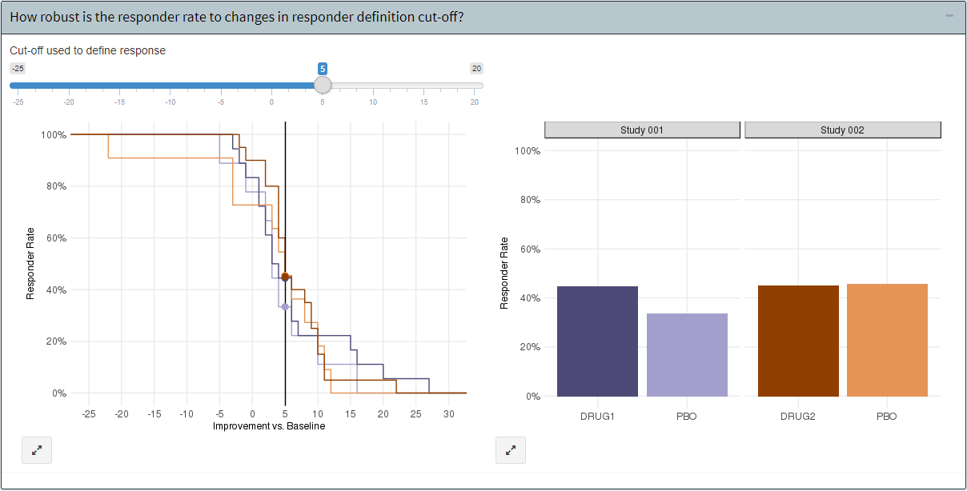
Analyse questions not data

Slide 42
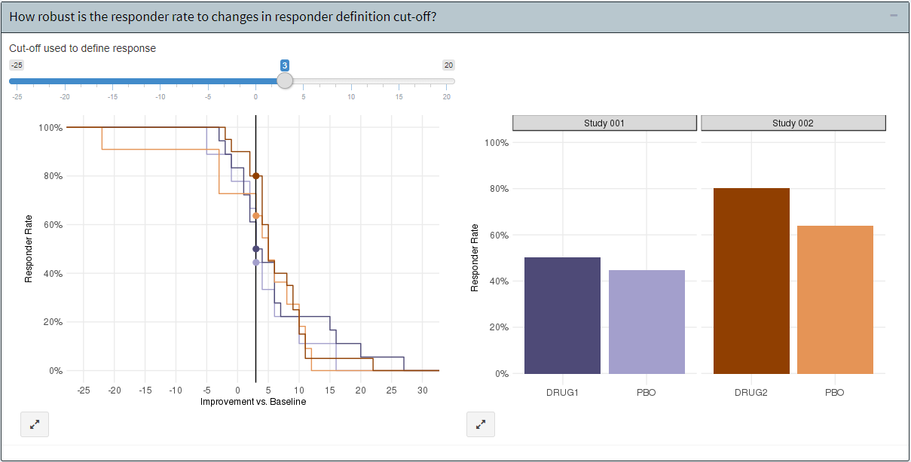
Analyse questions not data

Slide 43
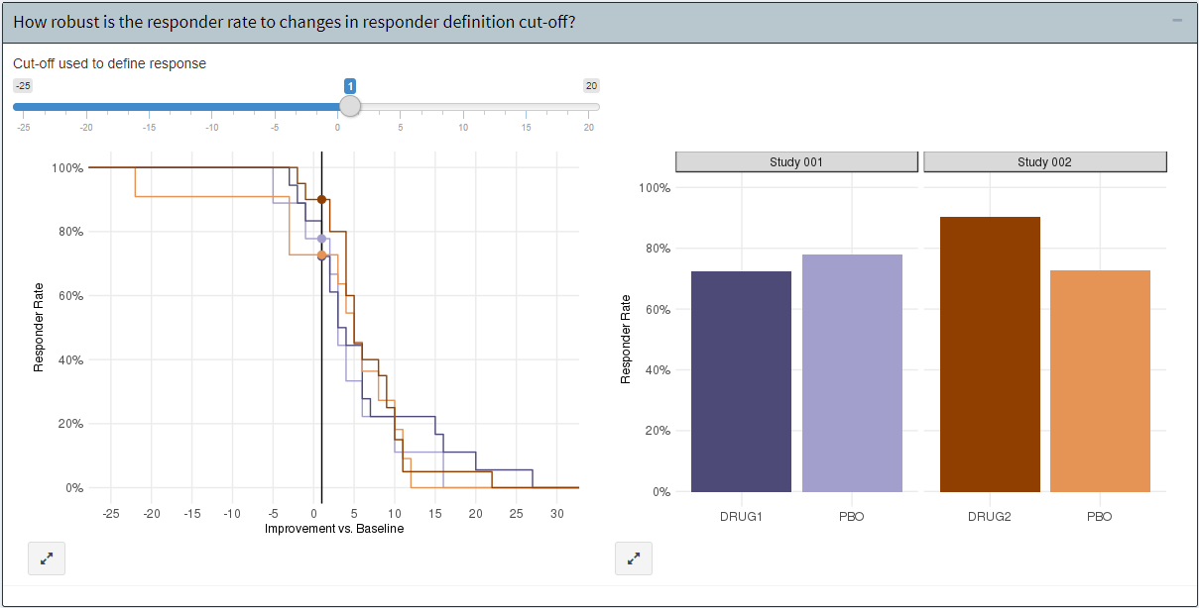
Analyse questions not data

Slide 44
Elements of a STRATOS VP initiative
Notes:
Call to action
- Visualise communication is important
- Enegage the vis panel
- Support it
- Join it.
Provide examples along workflow (i.e. topic groups)
List out the TGs – example graphs
Graphic with TG and THE graph – abstract it
What does success look like?
-People engage, use it. Website
-Blog – not just statuic content
-Tutorials / workshops
-Newsletters – keep it in peoples minds, keep at it. (kaizen – small steps over innovation)
People engage, use it. Website
Blog – not just statuic content
Tutorials / workshops
Newsletters – keep it in peoples minds, keep at it. (kaizen – small steps over innovation)
QBV – thinking of question and problem
Show the CDF and responder interactive example
Reporting guidelines
Less of the google like papers
People cut through hype (train scientific partners, not just methods / stats) link back to stratos levels 1-3. education
Graphical principles and thinking
Graphics Principles Cheat Sheet
Newsletter
Easing the implementation
Graph Gallery
Analysis Results Datasets
Standardization of most common/important graphs
Graphics tomorrow ... or today?
Question‐based visualizations and interactive graphics
...plus overarching stakeholder management and communication

Slide 45
Effective data visualisation is effective visual communication
Effective graphs...
are visually appealing, intuitive, legible
use the correct graph type and axis scales
use proximity & alignment to facilitate comparison
use labels and annotations to add clarity to the message
Most importantly, effective use of visualisations
Enables clear and impactful communication
Elevates influence with stakeholders
Facilitates informed decision making

Slide 47
Acknowledgements
Alison Margolskee
Marc Vandemeulebroecke
David Carr
Andrew Wright
Jürgen Löffler
Linda Kanitra
Baldur Magnusson
Matthew Brierley
David Ohlssen
Shaun Butcher
Julie Jones
Walter Hufford
Ruquan You
Ivan-Toma Vranesic
Ian Rees
Nicolas Guerro
Keo Chanthavinout
Frank Bretz

Slide 48
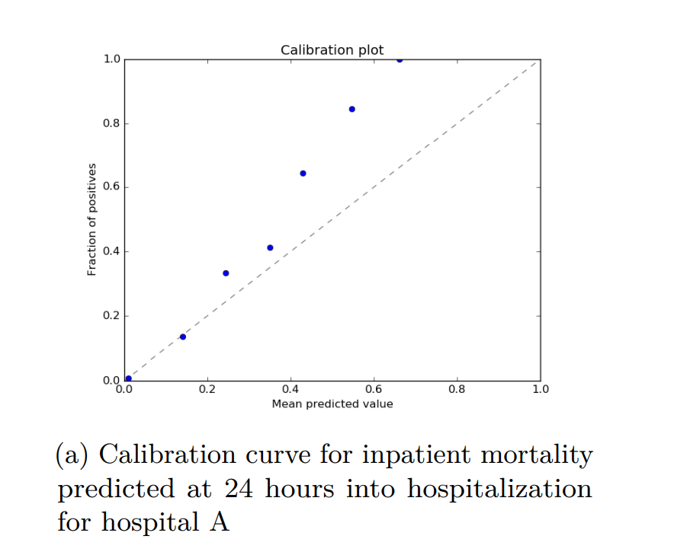

Slide 49
